Slide 1
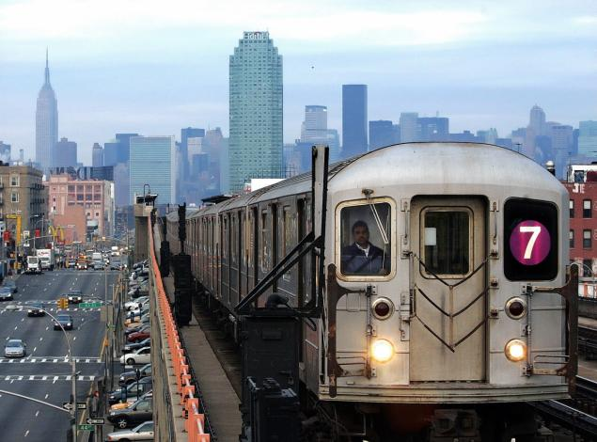
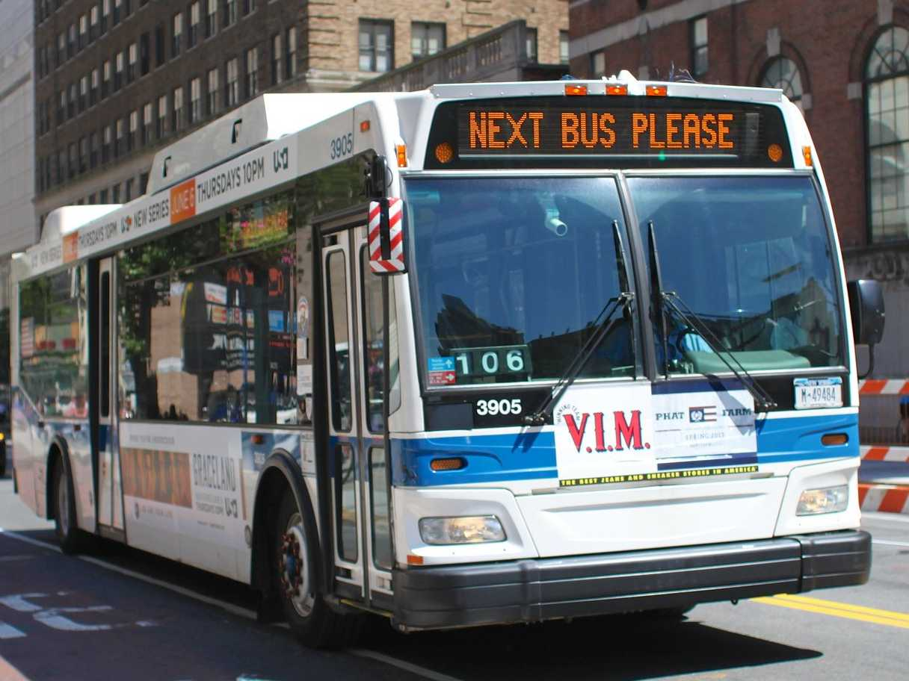
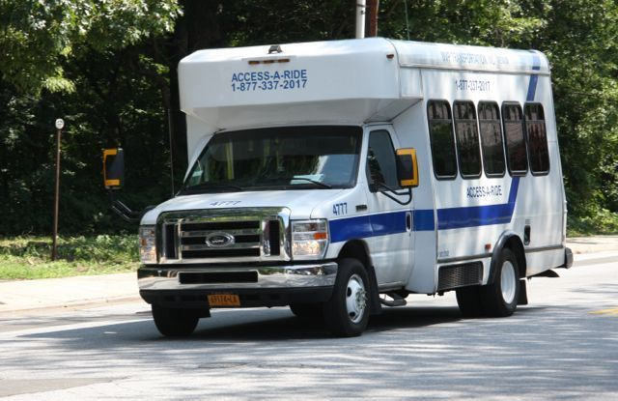
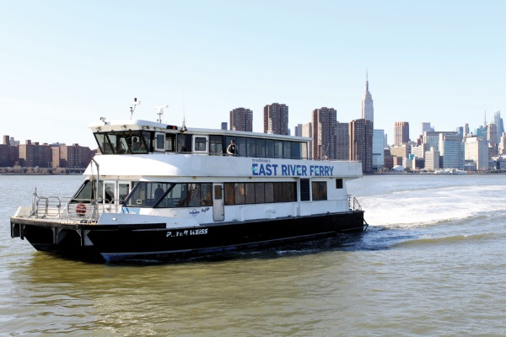
Notes:
NY has comprehensive transit network that we all love and use. Well, maybe not love. At least not the subway on the weekend. Transit ridership is the highest in NYC metro area and twice as much as its nearest competitor. Yet, an informal transport service has been serving communities in NY.

Slide 2

Notes:
They came during Transit Stike of 1980
Lots of operation outside of regulation
Brought under TLC in 1997
These vans had been quietly operating for a while but really came to the fore during the transit strike of 1980. The was practically no other way to get around.

Slide 3
100,000
Notes:
100,000 passengers a day.

Slide 4
500
Notes:
500 illegal vans
Regulation is not working

Slide 5
Why do people take dollar vans?

Slide 6
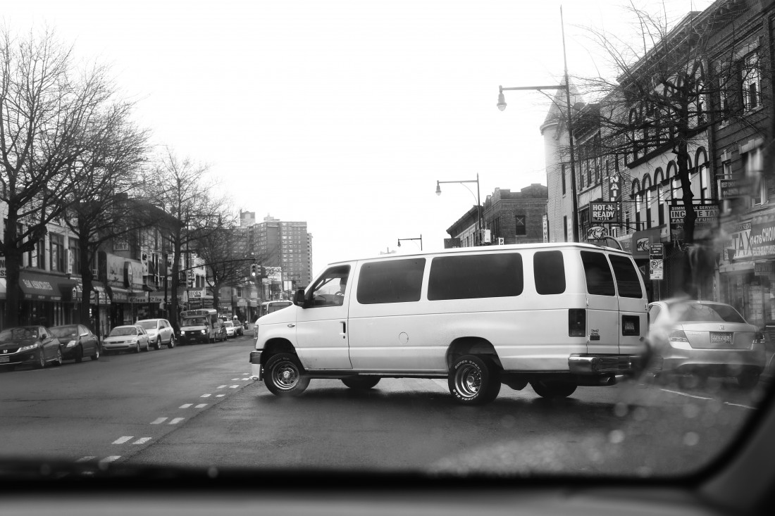
Something
Notes:
Street hail
Upcoming legislation is key
Should not kill vans
Do not make assumptions, speak to people

Slide 7
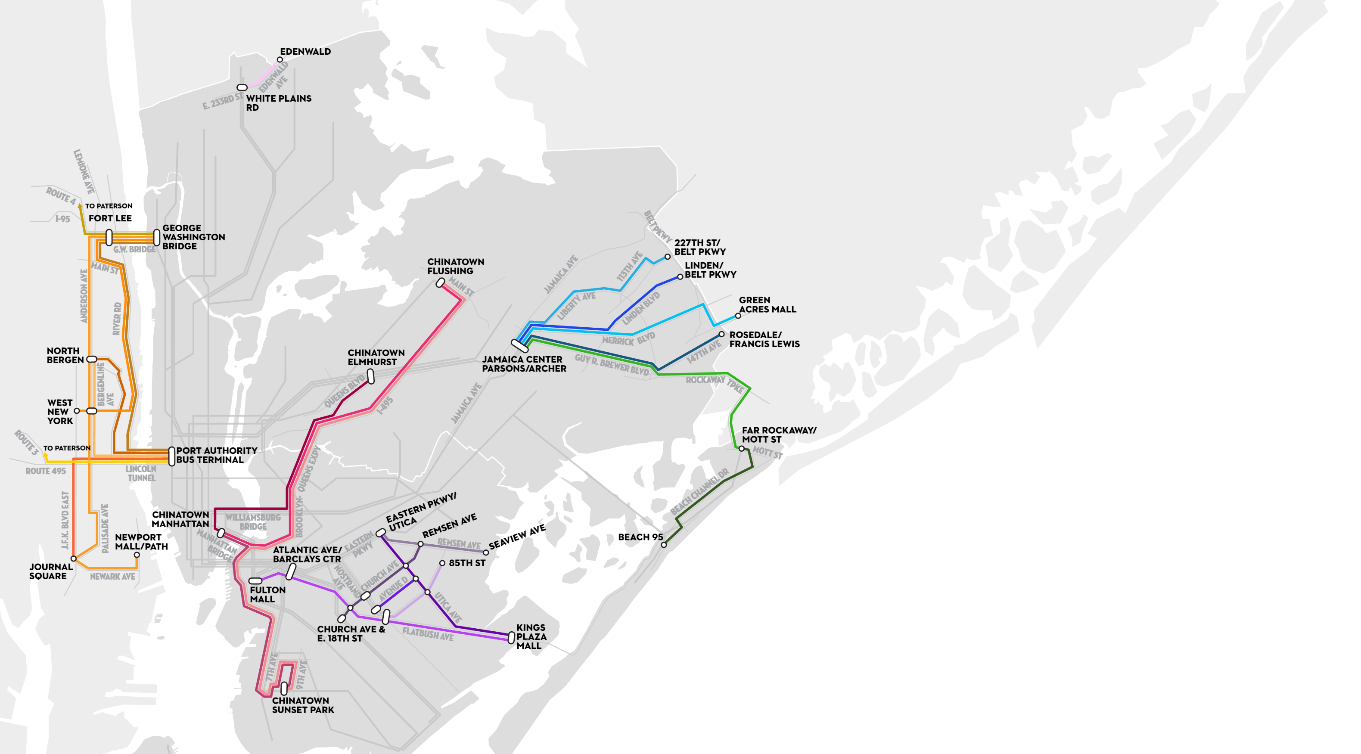
Notes:
We talked to three people:
-Interviewed Alex Ketting, the Director of the unit that oversees permitting
-Interviewed Journalist Aarron Riess
-Went on a dollar van ride ourselves

Slide 8
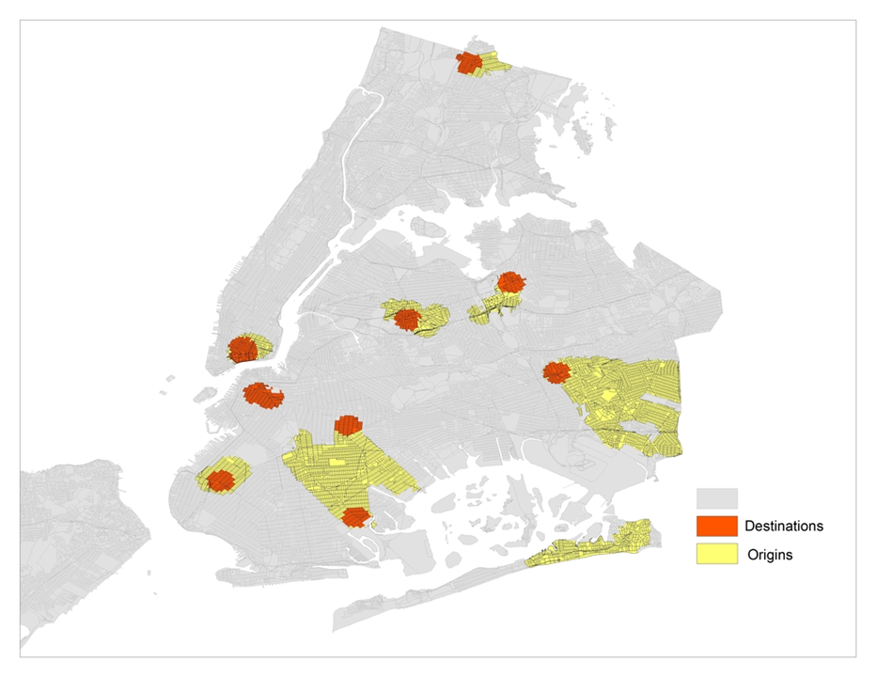
Origins and Destinations
Notes:
Two types of tracts, origins are yellow and destinations are orange
Destinations are where people got off and origins are where people could get on
We used GIS polylines and ½ mile buffers

Slide 9
Longitudinal Employer-Household Dynamics (LEHD)
American Community Survey
(ACS)
Notes:
LEHD LODES data was used to describe where people work and how much they make
The ACS was used for demographics

Slide 10
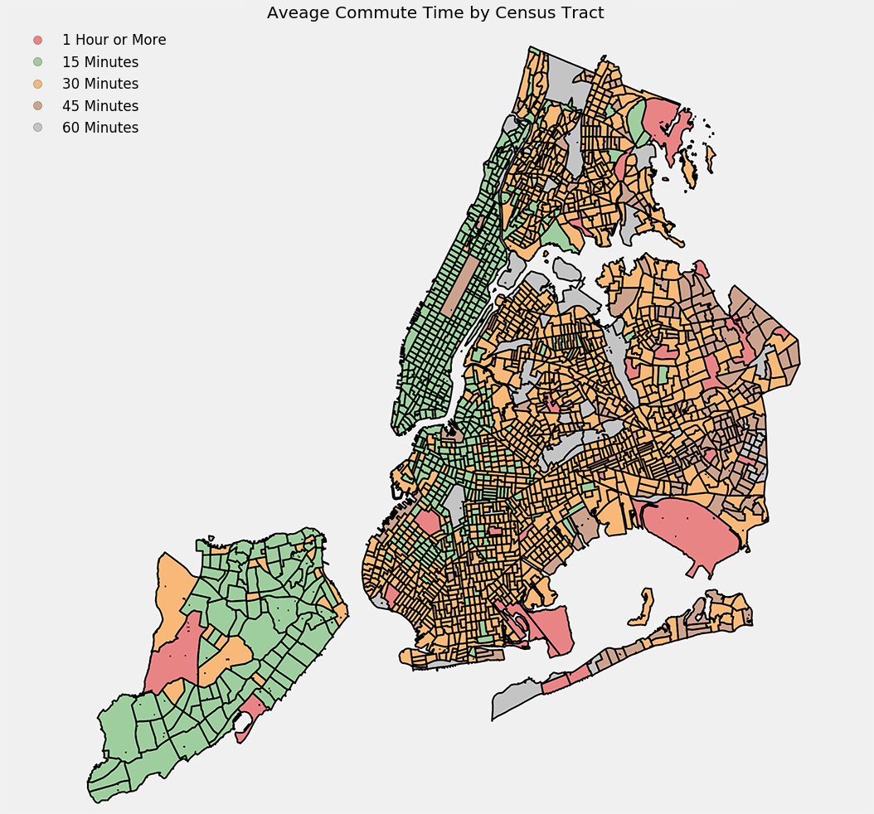
Notes:
Open Trip Planner is an open source package that accounts for street layouts and all public transit in a detailed way.
LEDH LODES tells us where people are commuting to and where they live
We created weighted averages for every person in every tract measuring how long they commute without dollar vans.

Slide 11
Feature Selection
+
Prediction
Notes:
We used SVM to select salient features
We also used SVM to create a model of tracts that could pick out a census tracts with these salient features

Slide 12
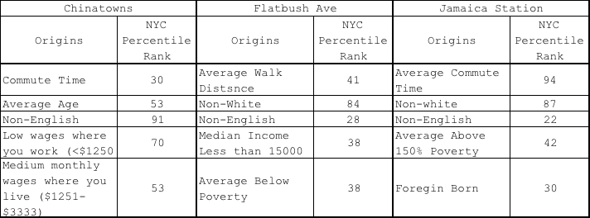
Dollar Van Origin Features
Notes:
Riders are not a Monolith, they very by ‘line’
Chinatown served cultural ties
Flatbush and East New York lines served as economic lifelines

Slide 13
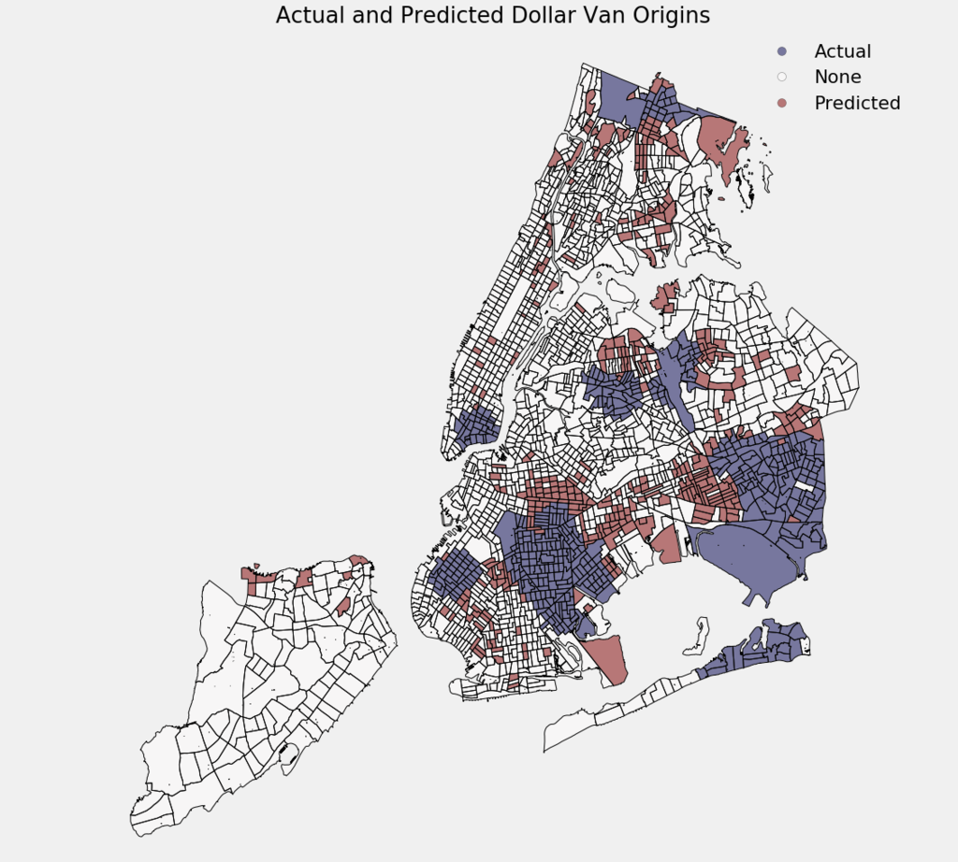
Notes:
Red are tracts that are similar to those with dollar vans

Slide 14

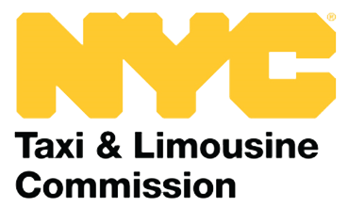
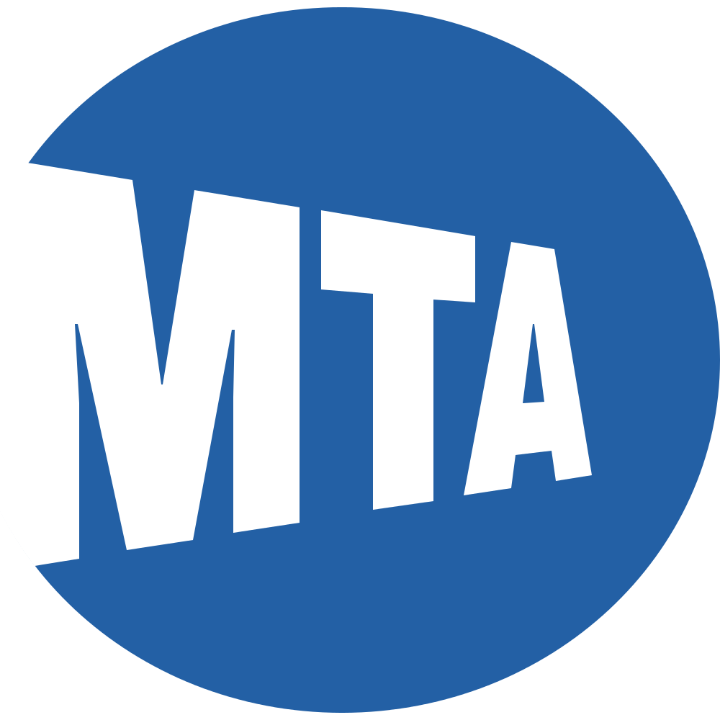
Implications
Notes:
DOT and TLC are the regulators
They need to use context in their permitting decisions
The MTA is not well placed to create ‘cultural’ van lines
The MTA should see the outer borough lines as a need for more formal investment
Both are serving vital functions and have their place in the ecosystem

Slide 15
Future Work
Notes:
Create a tool for TLC/DOT
Invest in infrastructure in East New York and where our predicative model says their could be dollar van demand

Slide 16
Notes:
Investigate other van lines (NJ, Long Island etc)
Find new van lines to document their routes

